Slide 1
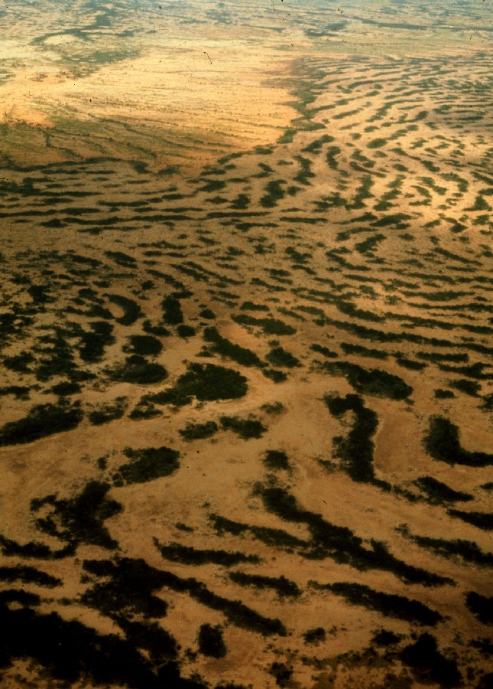
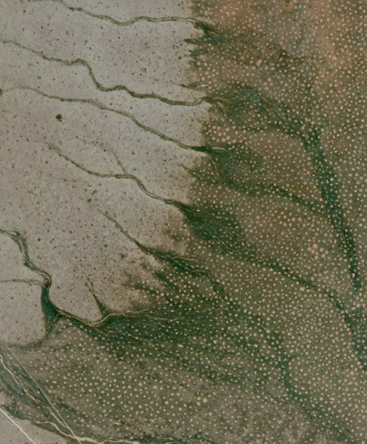
Pattern formation - a missing link in the study of ecosystem response to environmental changes
Resource-limited landscapes are patchy and often shows highly regular patterns
Fairy Circles in Namibia, S. Getzin
Ehud Meron
Department of Solar Energy & Environmental Physics
and
Physics Department
Ben-Gurion University
Winter School on
Patterns of vegetation in water controlled ecosystems
January 3-9, 2016, Venice
Such patterns are familiar from other natural contexts
Notes:
I’d like first to remind you that I am not an ecologist, don’t forget (behave gently)
It’s quite unusual and remarkable when two disparate scientific fields, invovlving completely different communities of scientists, begin to interface with one another. This is the case with landscape ecology and pattern formation. During the past decade numerous studies have appeared, field observations and model studies, supporting the view that such patchiness results from self organization or in the language of pattern formation, from symmetry breaking instabilities. Despite this extensive activity, the interface between the two disciplines is still at a very early stage of development. Experimentally, there isn’t even a single controlled laboratory experiment of vegetation pattern formation, and theoretically, most studies have remained at the level of numerical model simulations without any nonlinear analysis – the concepts and powerful methods of pattern formation theory have not been applied yet.
In this talk I want to present two studies that try to go beyond this level. Both studies are relevant to desertification in drylands so let me first say a few words about this topic.
During the past 50 years two disparate research fields have developed in parallel, landscape ecology and pattern formation – the development of symmetry breaking patterns in nature. It is only during the past 10 years or so that the relevance of pattern formation to landscape ecology has been recognized. Despite the increasing interest in this link, most studies have remained at the level of numerical model simulations without using advanced concepts and methods of pattern formation theory. In this talk I’ll present examples of more sophisticated applications of pattern formation theory, such as homoclinic snaking and spatial resonances, to desertification and restoration of degraded regions.
Let me begin with a few words about drylands and desertification which is one of the outstanding environmental problems we are currently face.

Slide 2
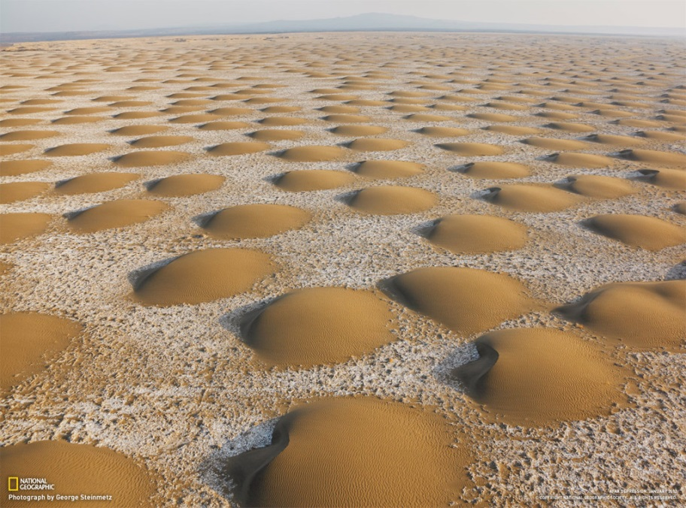
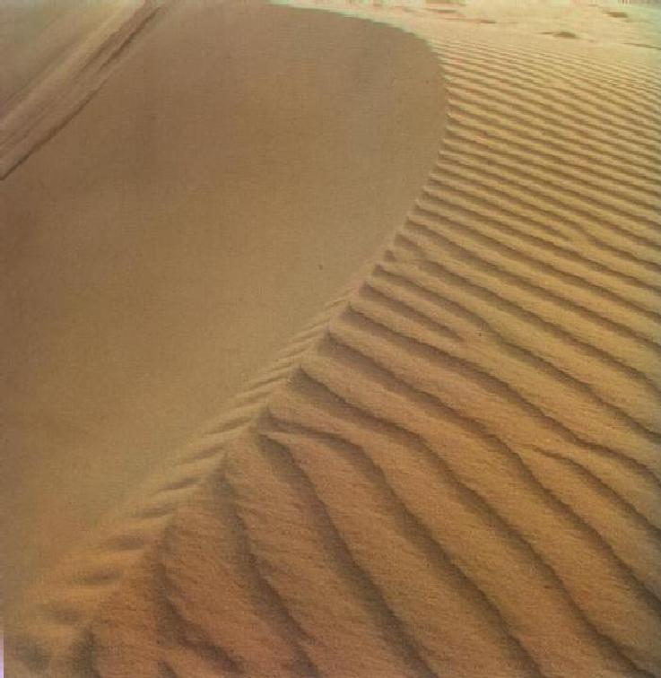
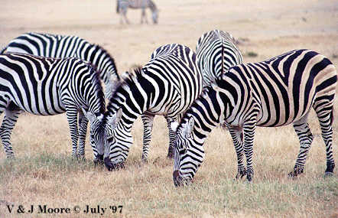
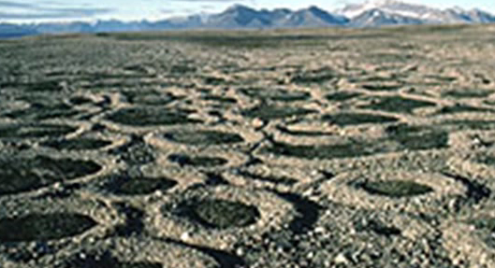
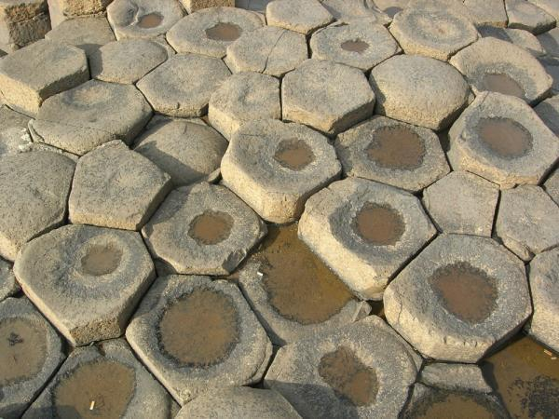
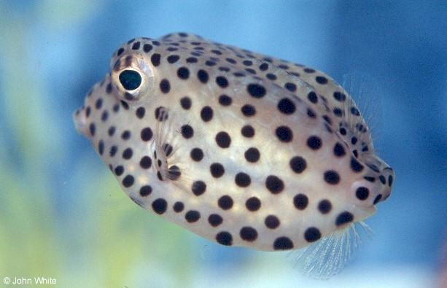
Ecosystem patchiness and pattern formation
Along with landscape ecology another field has developed during the past 50 years, by a different community (physicists and applied mathematicians) – pattern formation
Questions asked in pattern formation research include:
Mechanisms that create regular patterns in uniform systems (spatial self organization)
The origin of universality
Mechanisms for irregular or disordered patterns
Means of controlling patterns
Many more questions motivated by applications to specific systems
Ben Gurion University, Ehud Meron - www.bgu.ac.il/~ehud
The research involves controlled experiments on model systems and the development of a mathematical theory
Very relevant to ecology!
Notes:
בטבע קשה לבדוק אם התבניות הן תוצאה של אי יציבות אך אפשר לעשות זאת בנסיונות מעבדה מבוקרים

Slide 3
Outine
Lecture I: A glimpse into pattern formation theory
Basics of nonlinear dynamics: positive feedbacks and instabilities, linear stability analysis, bifurcation diagrams.
Pattern formation by pattern-forming instabilities, that is, non-uniform instabilities of uniform states or: stripe and hexagonal patterns.
Pattern formation by multi-stability, that is, by uniform instabilities that lead to multiplicity of stable uniform states: front dynamics and interactions.
Bistability of uniform and patterned states: localized structures and hybrid states.
Ben Gurion University, Ehud Meron - www.bgu.ac.il/~ehud
Lecture II: Pattern formation as a missing link in the study of
ecosystem response to environmental changes
Notes:
Many ecologists share the view that ecology is far more complicated than physics – the most you can do is building up a model that is tailored to a particular problem

Slide 4
Basics of nonlinear dynamics
The natural systems we mentioned represent open non-equilibrium systems, that continuously exchange materials and energy with their environments.
One of the first tasks in exploring such systems is defining what constitutes the “system” and what constitutes the system’s “environment”.
The distinction between the system and its environment depends on the processes they involve, which can be divided into two general groups:
Ben Gurion University, Ehud Meron - www.bgu.ac.il/~ehud
Bidirectional processes: Processes that mutually affect one another through various feedbacks.
Unidirectional processes: Processes that affect the bi-directional processes but are not affected by them.
Using this process classification we can introduce the concept of a dynamical system.

Slide 5
Nonlinear dynamics: defining a dynamical system
Dynamical system - a set of bidirectional processes, quantified by dynamical variables, U_{i}(t), that evolve in time according to some laws of motion (differential equations). These laws describe the mutual relationships among the dynamical variables and the manners by which they are affected by parameters, P_{i}(t), which represent the unidirectional impact of the system’s environment.
Laws of motion as ordinary differential equations (ODEs):
Ben Gurion University, Ehud Meron - www.bgu.ac.il/~ehud
P₁(t)
U₁(t)
Hanging glass pot of Dan
Or partial differential equations (PDEs)
U₃(t)
P₂(t)
Dynamical System
U₂(t)
Bidirectional processes (dynamical variables)
Unidirectional processes (parameters)
Environment

Slide 6
Nonlinear dynamics: instabilities
The bidirectional processes generally involve feedbacks, positive or negative:
Positive feedback
Positive feedback
Positive feedback
Negative feedback
+
+
+
Positive feedbacks drives instabilities
angle
U₁
U₂
torque
U₁
U₂
+
+
-
Ben Gurion University, Ehud Meron - www.bgu.ac.il/~ehud
A state of a system is stable if any small perturbation decays.
It is unstable if there exists a perturbation
that grows.
m
Example: A rod in a gravitational field
Vertical state is unstable to the growth of angular perturbations. The perturbations grow because of a positive feedback between the deviation angle and the gravitational torque.
F=mg
θ
L
Torque
= LFsinθ
Notes:
So what are the mechanisms that produce such patterns? These mechanisms are associated with two important feedbacks …

Slide 7
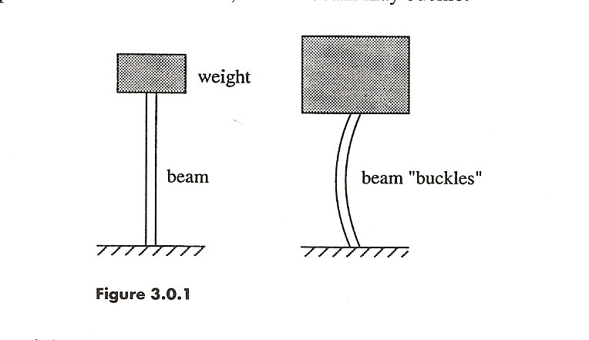
Nonlinear dynamics: instabilities
What happens beyond the onset of an instability?
The system evolves to a new state
Weight
Example: The buckling of a beam
There is a critical weight beyond which the beam buckles.
Straight beam
Buckled beam
Ben Gurion University, Ehud Meron - www.bgu.ac.il/~ehud
Mathematically, the dynamical system must be nonlinear:
f_{i} - a nonlinear function of {U_{j}}
(at least one of the {f_{i}} should be nonlinear)
The nonlinearity is needed to create the new buckled-beam state (in addition to the unstable straight-beam state) that the system converges to in the course of time.
Notes:
So what are the mechanisms that produce such patterns? These mechanisms are associated with two important feedbacks …

Slide 8
Nonlinear dynamics: instabilities
Back to the buckling of a beam:
Let,
u - measure the degree of buckling
Straight beam
Buckled beam
- the deviation from
the critical load
Close to the critical point, λ=0 (W=W_{C}), the system can be
described by the nonlinear dynamical system
Ben Gurion University, Ehud Meron - www.bgu.ac.il/~ehud
The nonlinear term -u³ creates two new steady states – symmetric left and right buckled states:
- the straight (unbuckled) state
- two symmetric buckled states
Notes:
So what are the mechanisms that produce such patterns? These mechanisms are associated with two important feedbacks …

Slide 9
Nonlinear dynamics: linear stability
It is not enough to know which states exist – we need to know whether the states are stable or unstable. This type of information is obtained by linear stability analysis.
Linear stability: A solution (state) u_{s} of a dynamical system $\dot{u}=f\left(u\right)$ is linearly stable if any infinitesimally small perturbation of u_{s} decays in the course of time.
Graphical view of linear stability: A solution u_{s} is stable (unstable) if the slope $f′(u_{s})$ of $f(u)$ at u_{s} is negative (positive).
Ben Gurion University, Ehud Meron - www.bgu.ac.il/~ehud
Back again to the buckled beam example:
λ < 0
λ > 0
f(u)
f(u)
Stable
Unstable
Stable

Slide 10
Nonlinear dynamics: bifurcation diagrams
The two information items, existence and stability are summarized in a bifurcation diagram:
λ < 0
λ > 0
Ben Gurion University, Ehud Meron - www.bgu.ac.il/~ehud
Stable
Unstable
An instability described by such a diagram is called a pitchfork bifurcation
In practice the two buckled states need not be perfectly symmetric, and the instability may favor one state over the other. Mathematically, such imperfections are described by additional terms that break the symmetry $u→−u,$ such as a constant term or $u^{2}.$

Slide 11
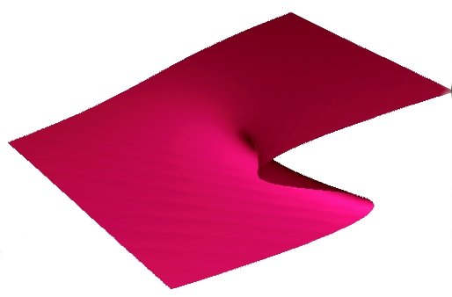
Nonlinear dynamics: the cusp singularity
$$\dot{u}=λu−u^{3}+au^{2}+b=0$$
$$u$$
Cusp singularity
$$b$$
Ben Gurion University, Ehud Meron - www.bgu.ac.il/~ehud
λ
Cuts at constant b values:
u
u
u
b > 0
b = 0
b < 0
λ
λ
λ

Slide 12
Nonlinear dynamics: the cusp singularity
$$\dot{u}=λu−u^{3}+au^{2}+b=0$$
$$u$$
Cusp singularity
$$b$$
Ben Gurion University, Ehud Meron - www.bgu.ac.il/~ehud
λ
Cuts at constant λ values:
u
u
u
b
λ < 0
b
λ = 0
b
λ > 0

Slide 13
Nonlinear dynamics: bistability and hysteresis
u
u₊(b)
Bistability - two alternative
stable states in b_{min} <b< b_{max}
Hysteresis:
different transition points upon
increasing and decreasing b.
0
u₋(b)
Introduced in the context of magnetism, exists in numerous other contexts
b_{max}
b
b_{min}
0
Ben Gurion University, Ehud Meron - www.bgu.ac.il/~ehud
Coexistence of
Stable states
In ecology – “catastrophic” regime shifts (Scheffer et al. Nature 2001):
Desertification – sudden decrease in biological productivity as a result of climate fluctuations (droughts) and human- related activities (over-grazing).
Sudden loss of transparency and vegetation in shallow lakes subjected to human-induced eutrophication.
Notes:
Eutrophication is a process whereby lakes receive excess nutrients that stimulate excessive plant growth (algal bloom). This enhanced plant growth reduces dissolved oxygen in the water when dead plant material decomposes and can cause other organisms to die. Nutrients can come from many sources, such as fertilizers applied to agricultural fields, golf courses, and suburban lawns; deposition of nitrogen from the atmosphere; erosion of soil containing nutrients; and sewage treatment plant discharges.
Herbivores consume seedlings of young trees and prevent their growth, thus stabilizing open grasslands.

Slide 14
Nonlinear dynamics: bistability and hysteresis
u
$$\dot{u}=λu−u^{3}+au^{2}+b=0$$
u
Also induces a bistability
range:
of and
Note: as λ is increased past a pair of stable and
unstable states appear – this is the saddle-node or the
fold bifurcation.
Ben Gurion University, Ehud Meron - www.bgu.ac.il/~ehud
Mathematically it is described by
Its bifurcation diagram is:
Notes:
Eutrophication is a process whereby lakes receive excess nutrients that stimulate excessive plant growth (algal bloom). This enhanced plant growth reduces dissolved oxygen in the water when dead plant material decomposes and can cause other organisms to die. Nutrients can come from many sources, such as fertilizers applied to agricultural fields, golf courses, and suburban lawns; deposition of nitrogen from the atmosphere; erosion of soil containing nutrients; and sewage treatment plant discharges.
Herbivores consume seedlings of young trees and prevent their growth, thus stabilizing open grasslands.

Slide 15
Pattern forming instabilities: symmetry breaking
A spatially extended system generally shows non-uniform distributions of the state variables.
Fairy Circles in Namibia, S. Getzin
The non-uniformity can originate from:
A non-uniform environment, e.g. topography
Self organization
Ben Gurion University, Ehud Meron - www.bgu.ac.il/~ehud
Focus on self-organization in uniform environments.
Such systems generally have uniform states that can go through instabilities.
When the fastest growing perturbation is uniform the instability results in another uniform state – a uniform instability.
When it is non-uniform it results in a patterned state – a non-uniform instability
Notes:
So what are the mechanisms that produce such patterns? These mechanisms are associated with two important feedbacks …

Slide 16
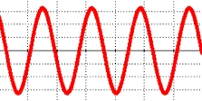
Pattern forming instabilities : symmetry breaking
We say that the spatial pattern that appears in a non-uniform instability breaks the translational symmetry of the system.
Mathematically, any perturbation about the uniform state can be represented as a sum of sinusoidal perturbations of
L
different wavelength $L$or wavenumber $k$ (Fourier series).
Let $(k)$ be the growth rate of a perturbation with wavenumber $k$. In a non-uniform instability the fastest growing perturbation has a a nonzero wavenumber $k$, i.e. it is spatially structured:
Ben Gurion University, Ehud Meron - www.bgu.ac.il/~ehud
σ
λ < 0
λ = 0
λ > 0
σ <0 for all k
σ(k₀)=0
σ >0 for k band
0
k₀
k₀
k₀
k
Uniform state is stable
Uniform state is marginally stable
Uniform state is unstable
Out of all $k$ the one that begins to grow will show up and dictate the periodic pattern that emerges – in 1d
Notes:
So what are the mechanisms that produce such patterns? These mechanisms are associated with two important feedbacks …

Slide 17
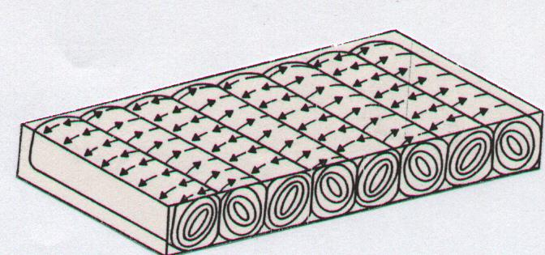
Pattern forming instabilities: experiments in fluid dynamics
Heating a fluid layer from below uniformly (Rayleigh-Bénard):
Henri Bénard, 1900
T_{top}
T_{bot}
Cold fluid
Visualization by illuminating from below (index of refraction changes with temperature periodically).
Hot fluid
Ben Gurion University, Ehud Meron - www.bgu.ac.il/~ehud
Below a critical temperature difference,
the fluid is at rest (heat transfer by molecular conduction)
Above ΔT_{C} the rest state loses stability and convection sets in the form of ordered parallel rolls
When the fluid is damp atmospheric air, the cooling down of an ascending hot air can results in water condensation and cloud street formation
What positive feedback drives this instability?

Slide 18
Pattern forming instabilities: experiments - RB convection
top plate
T₂<T₁
Colder fluid layer → heavier
T₁+δT
Temperature
T₁
A fluid layer with a hotter “fluid particle”
T₁+δT
Density
Bottom plate
Ben Gurion University, Ehud Meron - www.bgu.ac.il/~ehud
As the hotter (lighter) fluid particle moves up it experience a yet colder environment and the buoyancy force upward increases.
+
A positive feedback between temperature and buoyancy:
Temperature deviation
Buoyancy force
Why is there a threshold for the instability?
+
The buoyancy force has to overcome two stabilizing factors: heat diffusion and fluid viscosity.

Slide 19
Pattern forming instabilities: stripe and hexagonal patterns
In 2 space dimensions: periodic stripes in different directions
L
Rotated 120⁰
Rotated 120⁰
Ben Gurion University, Ehud Meron - www.bgu.ac.il/~ehud
The 3 wave-vectors resonate and enhance one another
(provided there is no inversion symmetry $u→−u)$

Slide 20
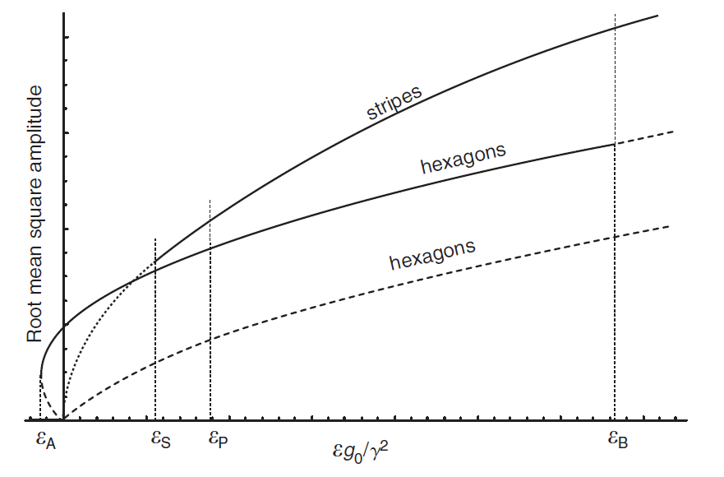
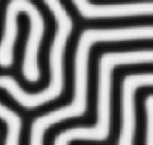
Pattern forming instabilities: stripe and hexagonal patterns
Bifurcation diagram for stripe and hexagonal patterns:
S
(spots)
H₀
(gaps)
Ben Gurion University, Ehud Meron - www.bgu.ac.il/~ehud
H_{π}
zero
λ
λ_{f}
λ_{s}
3 states, bistability ranges of any pair of consecutive states
λ_{h}
Labyrinths
in isotropic systems
zero
spots
stripes

Slide 21
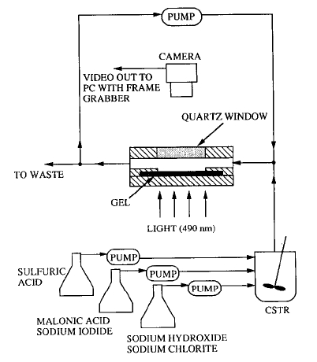
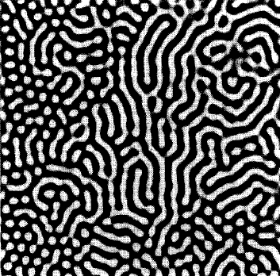
Pattern forming instabilities: stripe and hexagonal patterns
Example: Turing instability in a chemical reaction - the chlorite-iodide-malonic acid (CIMA) reaction
(Vigil, Ouyang and Swinney, Physica A 1992)
Ben Gurion University, Ehud Meron - www.bgu.ac.il/~ehud
Shows stripe or labyrinthine patterns along with hexagonal patterns, indicating a bistability range of the two patterns.

Slide 22
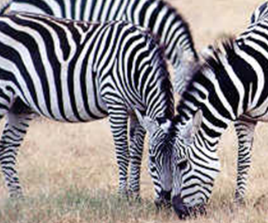
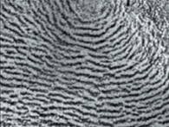
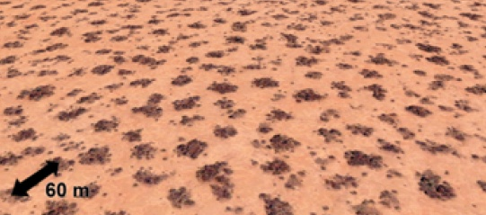
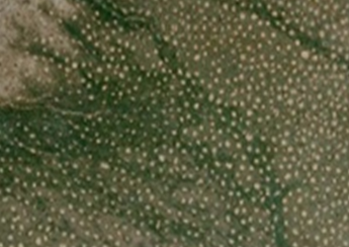
Pattern forming instabilities: universalilty
Why do we see the same universal patterns in different systems?
Stripes in zebra, clouds and woody vegetation.
Spots in fish coats, rock patterns, and woody vegetation
Ben Gurion University, Ehud Meron - www.bgu.ac.il/~ehud
Different systems that go through the same instability type behave similarly. Mathematically, different systems PDE models that share the same type of instability are reducible, near the instability point, to the same dynamic equations – the normal form equations
Note: the positive feedbacks that are responsible for the instabilities are system specific.
Notes:
So what are the mechanisms that produce such patterns? These mechanisms are associated with two important feedbacks …

Slide 23
Pattern formation in multi-stable systems: fronts
Even when the fastest growing perturbation is uniform, pattern formation is still possible provided the instability results in a multiplicity of stable uniform states.
σ
Consider bistability of uniform states:
0
k
0
u
u₊
u
u₊
Ben Gurion University, Ehud Meron - www.bgu.ac.il/~ehud
b
u₋
u₋
We can prepare initial patterns of alternating up and down states:
Question: will they persist in time?
space

Slide 24
Pattern formation in bistable systems: fronts
The fate of such initial domain patterns depends on the dynamics of the fronts that separate the up and down states.
Two aspects of these dynamics:
Motion of a single front
Interaction between adjacent fronts
front
State variable
A useful concept:
The Lyapunov function (or “energy” function) - a quantity that
Ben Gurion University, Ehud Meron - www.bgu.ac.il/~ehud
cannot increase in time.
No explicit time dependence
Consider as an example:
Then
⇒ V is a Lyapunov function

Slide 25
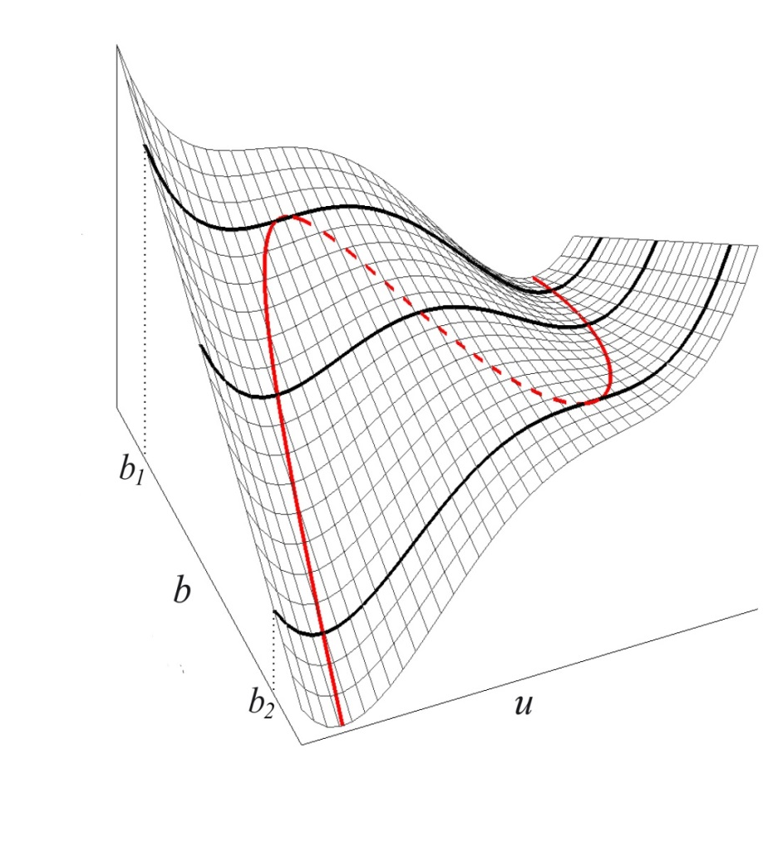
Pattern formation in bistable systems: fronts
How does $V$ look like for $λ>0$?
Integration of
$$\frac{dV}{du}=−λu+u^{3}−b$$
$$V$$
gives
$$V=−\frac{λ}{2}u^{2}+\frac{1}{4}u^{4}−bu+V_{0}$$
Consider bistability of uniform states:
Since $\dot{u}=−\frac{dV}{du} ,$extremum points of $V$ correspond to steady-state solutions.
u
+
Ben Gurion University, Ehud Meron - www.bgu.ac.il/~ehud
Since $\frac{dV}{dt}≤0 ,$minima of $V$ correspond to stable steady-state solutions, while maxima correspond to unstable states.
b
-
For any fixed value of $b$ in the range $b_{1}<b<b_{2}$ the function $V$ has two minima, which correspond to the two stable states, $u_{±}$. The two minima and the maximum in between trace the the sigmoidal red line, which we are already familiar with:
u
u₊
At $b=b_{1} or b_{2}$ one of the minima coincides with
the maximum and disappear, leaving only one minimum.
b
u₋

Slide 26
Pattern formation in bistable systems: front motion
Why is the Lyapunov function V significant for front dynamics?
The two stable states in a bistable system may have different values of V ⇒ the constraint to minimze V implies front motion.
$$c$$
$$x$$
$$x$$
$$c$$
$$c$$
Ben Gurion University, Ehud Meron - www.bgu.ac.il/~ehud
If $V\left(u_{+}\right)<V\left(u_{−}\right)  c>0$ the up state invades the down state
If $V\left(u_{+}\right)>V\left(u_{−}\right)  c<0$ the down state invades the up state
In order for this to happen there should be some spatial coupling. Most often it is diffusive:
$$\frac{∂u}{∂t}=λu−u^{3}+b+\frac{∂^{2}u}{∂x^{2}}$$
Ginzburg-Landau (GL) equation
Note: if there’s a reflection symmetry $x→−x$, then if $u\left(x\right)$ is a solution with a speed $c$, also $u\left(−x\right)$ is a solution but with a speed $–c$ (no such symmetry for vegetation on slopes).

Slide 27
Pattern formation in bistable systems: front interactions
Back to the question whether initial patterns of alternating up and down-state domains can persist in time:
The single front analysis can tell us what will happen at early times when the front are still far apart and do not “feel” one another. As the fronts get closer front interactions become significant.
Ben Gurion University, Ehud Meron - www.bgu.ac.il/~ehud
Front interactions can be attractive or repulsive (or both).
Attractive interactions:
Time
Will result in the convergence to a uniform up state or down state

Slide 28
Pattern formation in bistable systems: front interactions
Repulsive interactions:
Time
can result in stationary stable patterns.
Cannot be obtained with the GL equation, but can be obtained with an activator-inhibitor (AI) system.
Example: FitzHugh-Nagumo (FHN) model
Ben Gurion University, Ehud Meron - www.bgu.ac.il/~ehud
v
$$\frac{∂u}{∂t}=u−u^{3}−v+\frac{∂^{2}u}{∂x^{2} }$$
(u₊,v₊)
$$\frac{∂v}{∂t}=ε(u−a_{1}v−a_{0})+δ\frac{∂^{2}v}{∂x^{2} }$$
u
(u₋,v₋)
$$ε=τ_{u}/τ_{v}$$
$$δ=D_{v}/D_{u}$$
$u$ - activator: activate the growth of itself and of $v$
$v$- inhibitor: inhibits the growth of itself and of $u$

Slide 29
Pattern formation in bistable systems: front interactions
The FHN model has front solutions
v
u₊
v₊
(u₊,v₊)
v₋
u
u₋
(u₋,v₋)
When the inhibitor diffuses faster than the activator, diffusion of v into the space between approaching fronts inhibits the growth of u and can stop the front motion.
Ben Gurion University, Ehud Meron - www.bgu.ac.il/~ehud
Time
Bistable AI systems with fast diffusing inhibitor generally show stationary patterns of alternating up and down-state domains.

Slide 30
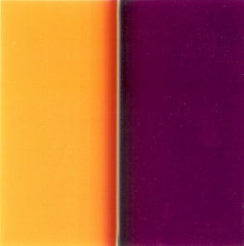
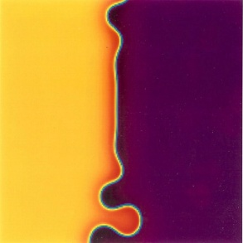
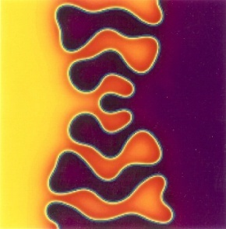
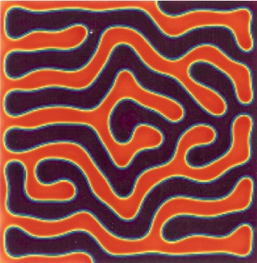
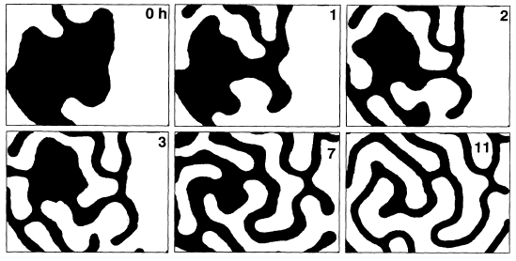
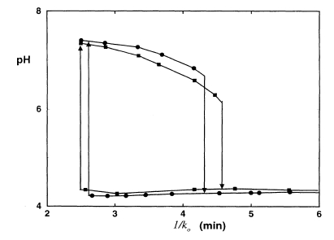
Pattern formation in bistable systems: front instabilities
In two space dimensions (2d) fast inhibitor diffusion can destabilize a linear front and lead to stationary labyrinthine patterns:
+
Bulge growth
Side diffusion
+
Time
Example: the FIS (ferrocyanide-iodate-sulfite) reaction - bistable system of high (white) and low (black) pH (Lee & Swinney, PRE 1995).
Ben Gurion University, Ehud Meron - www.bgu.ac.il/~ehud
Bistability and hysteresis in the FIS reaction

Slide 31
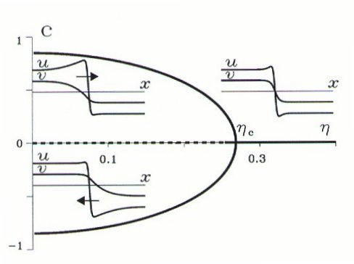
Pattern formation in bistable systems: front instabilities
Unlike the GL equation, the FHN model does not necessarily have a Lyapunov function for all parameter values.
If a Lyapunov function exists (“gradient” system) there must be a unique direction of front propagation. If it does not exist (“non-gradient” system), such a restriction does not apply.
Indeed, under certain conditions, two stable fronts propagating in opposite directions can exist. They appear in a pitchfork bifurcation - the Non-equilibrium Ising-Bloch (NIB) bifurcation
(Hagberg & Meron, Nonlinearity, 1994; Phys. Rev. Lett. 1994; Chaos 1994)
Ben Gurion University, Ehud Meron - www.bgu.ac.il/~ehud
v
Up-state (+) $→$ Down-state (-)
(u₊,v₊)
Ising front
Bloch fronts
u
(u₋,v₋)
Down-state (-)$→$ Up-state (+)
This behavior occurs for slow inhibitor, both in terms of local dynamics and spatial diffusion.

Slide 32
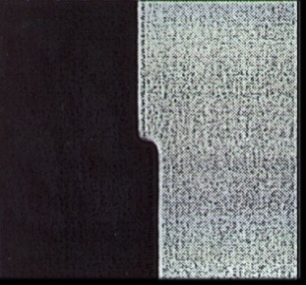
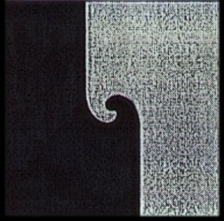
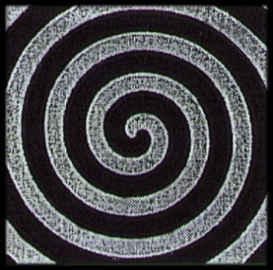
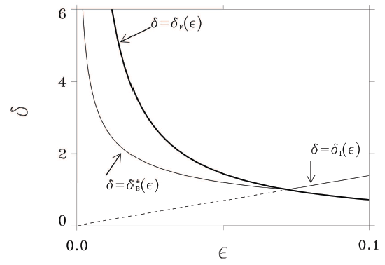
Pattern formation in bistable systems: front instabilities
The NIB instability allows for traveling waves:
- $→$ +
+ $→$ -
In 2D - rotating
spiral waves:
Time
Two front instabilities:
A longitudinal instability (NIB) that can lead to traveling (spiral) waves
A transverse instability that can lead to labyrinthine patterns
Ben Gurion University, Ehud Meron - www.bgu.ac.il/~ehud
NIB instability
Labyrinthine patterns
$$δ$$
Transverse instabilities
Spiral waves
What may happen when the two instabilities occur together?
$$ε$$

Slide 33
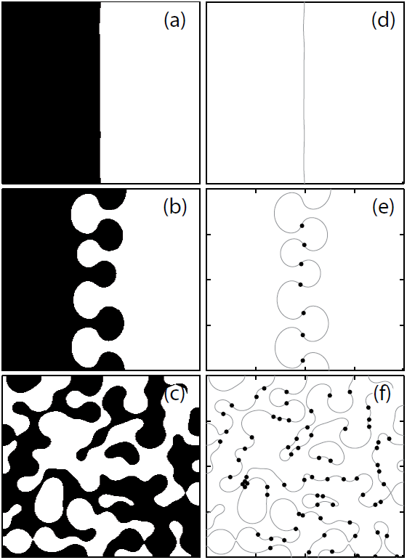
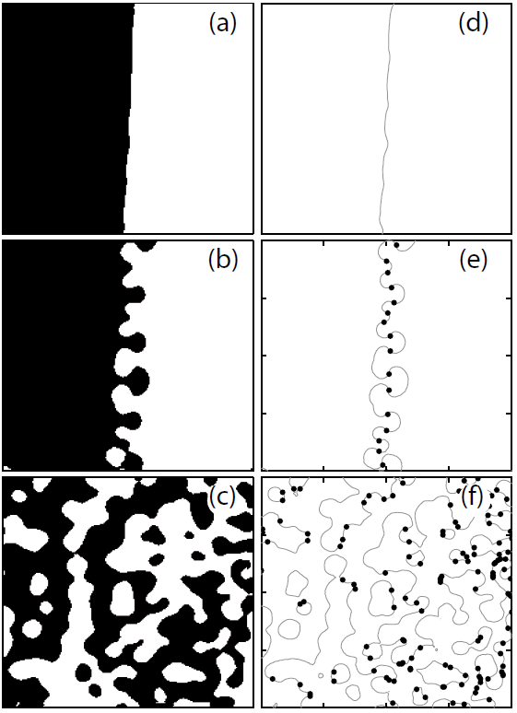
Pattern formation in bistable systems: front instabilities
Transverse + NIB ⇒ spatio-temporal chaos:
(Hagberg & Meron, Phys. Rev. Lett. 1994; Chaos 1994; Phys. Rev. Lett. 1997)
Simulations of the FHN model: The dynamics involve local front reversal and nucleation of pairs of spiral waves.
Time
Similar behavior in oscillatory systems periodically forced in time:
Bistability of two oscillating states with a phase shift of $π$
(Marts, Hagberg, Meron, Lin, Phys. Rev. Lett. 2004)
Ben Gurion University, Ehud Meron - www.bgu.ac.il/~ehud
Model (FCGL)
Experiment (forced BZ )

Slide 34
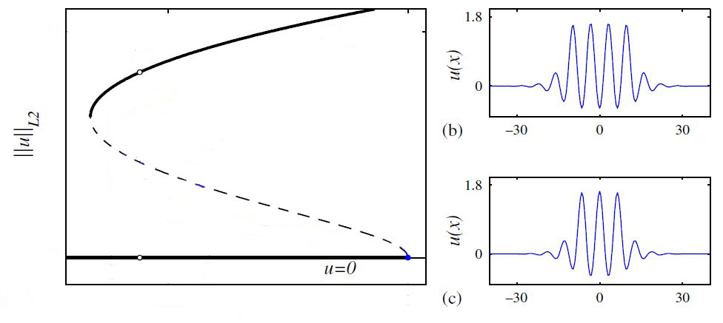
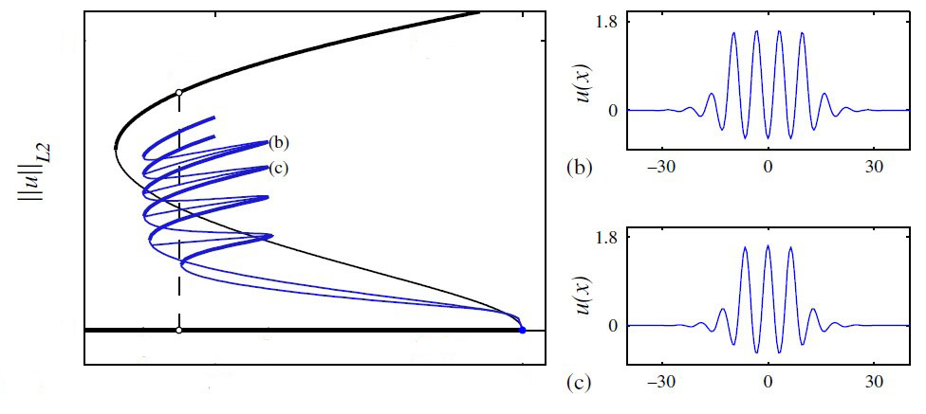
Pattern formation in bistable systems: localized patterns
Yet another case of bistability - a uniform state going through a non-uniform instability that results in bistability of the original uniform state and a periodic pattern state. Such systems give rise to localized patterns.
Consider for example:
patterned state
patterned state
Ben Gurion University, Ehud Meron - www.bgu.ac.il/~ehud
uniform state
uniform state
λ
λ
Homoclinic snaking (Knobloch, Nonlinearity 2008)
Notes:
This type of localized structures has been studied recently in simpler models by several groups. The appearance of these LS has been associated with what they call homoclinic snaking

Slide 35
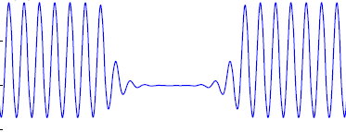
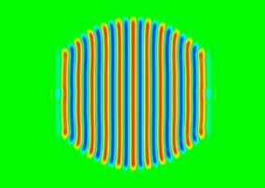
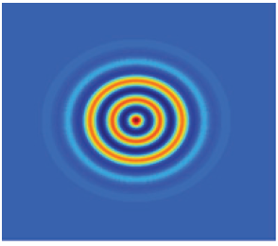
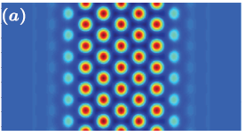
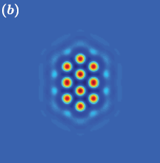
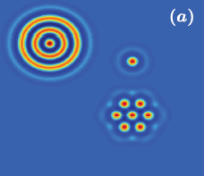
Pattern formation in bistable systems: localized patterns
In addition: solutions describing holes
in periodic patterns:
And in 2d:
Ben Gurion University, Ehud Meron - www.bgu.ac.il/~ehud
Lloyd, Sandstede†, Avitabile, Champney, SIADS 2008; Avitabile, Lloyd, Burke, Knobloch, Sandstede† 2012.
Almost any combination of such localized structures forms a stable pattern
J. Fineberg
Notes:
This type of localized structures has been studied recently in simpler models by several groups. The appearance of these LS has been associated with what they call homoclinic snaking

Slide 36
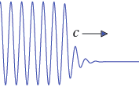
Pattern formation in bistable systems: localized patterns
The reason why these localized patterns appear is that fronts that
separate uniform and patterned states are pinned in a range of the
control parameter λ - the snaking range
(Pomeau, Physica D 1986)
C=0
patterned state
In bistability of 2 uniform states the front is stationary only when the energies (Lyapunov function) of the 2 states are equal – occurs at a particular value of λ –
Ben Gurion University, Ehud Meron - www.bgu.ac.il/~ehud
uniform state
the Maxwell point, λ_{max}
λ_{max}
λ
When one state is patterned the front can be stationary even if the
energies are not equal. This is because the energy varies
periodically with the pattern phase and phase values for which the
energy has minima represent stable states.
Notes:
This type of localized structures has been studied recently in simpler models by several groups. The appearance of these LS has been associated with what they call homoclinic snaking

Slide 37
Summary of Lecture I
Uniform stationary states may go through two types of pattern forming instabilities:
Non-uniform instabilities (fastest growing perturbation has a non-zero wavenumber) which lead to stripe and hexagonal patterns.
Control parameter
Uniform instabilities (fastest growing perturbation has zero wavenumber) which lead to bistability of uniform states, and to patterns of alternating up and down-state domains separated by fronts.
Ben Gurion University, Ehud Meron - www.bgu.ac.il/~ehud
Repulsive front interactions can lead to stable stationary patterns. A transverse front instability leads to labyrinthine patterns.
In non-gradient systems a longitudinal front bifurcation (NIB) can lead to traveling waves (e.g. spiral waves). The combination of both front instabilities can lead to spatio-temporal chaos.

Slide 38
Summary of Lecture I
The uniform and hexagonal-pattern states have in general a bistability range. In this range fronts can be pinned by the phase of the patterned state to form a multitude of localized structures and disordered patterns consisting of spatial mixtures of these structures.
Note: We confined ourselves to stationary instabilities (monotonic growth). There are also oscillatory instabilities which can lead to uniform oscillations, traveling waves and spatio-temporal chaos.
Ben Gurion University, Ehud Meron - www.bgu.ac.il/~ehud
Spatial patterns induced by instabilities are universal; the same patterns appear in different systems that go through the same instability.
But the positive feedbacks that drive these common instabilities are system specific ⇒
Almost any model from the shelf can reproduce observed patterns. However, in order to relate the patterns and their dynamics to physical and biological parameters of a specific system and make concrete predictions we must study system-specific models.

Slide 39
New book
About the book
Nonlinear Physics of Ecosystems introduces the concepts and tools of pattern formation theory and demonstrates their utility in ecological research using problems from spatial ecology.
The first part of the book gives an overview of pattern formation and spatial ecology, showing how these disparate research fields are strongly related to one another. The next part presents an advanced account of pattern formation theory. The final part describes applications of pattern formation theory to ecological problems, including self-organized vegetation patchiness, desertification, and biodiversity in changing environments.
Focusing on the emerging interface between spatial ecology and pattern formation, this book shows how pattern formation methods address a variety of ecological problems using water-limited ecosystems as a case study.
Reviews:
Editor invited: in CRC’s book webpage
In Journals:
Hugo Fort, Physics Today, 68(10), 46 (2015)​
​​​​​​​​K. Alan Shore, Contemporary Physics​ (2015)
D. DeAngelis, upcoming in SIAM.
Ben Gurion University, Ehud Meron - www.bgu.ac.il/~ehud

